Slide 1

Estimating causal
effects of policy interventions
Workshop ODISSEI
Oisín Ryan & Erik-Jan van Kesteren

Slide 2
https://is.gd/sicsscausal

Slide 3


About me
Erik-Jan van Kesteren
Background in statistics / social science
Assistant professor @ methodology & statistics UU
Social Data Science team lead @ ODISSEI (consortium of universities)
Some stuff I work on:
Latent variables, high-dimensional data, optimization, regularization, visualisation, Bayesian statistics, multilevel models, spatial data, generalized linear models, privacy, synthetic data, high-performance computing, software development, open science & reproducibility

Slide 4
Today’s Goal
A brief practical introduction evaluating the causal effects of policy interventions

Slide 5
The plan
Introduction
Policy Interventions and Causal Inference
Pre-Post Analyses and Difference-in-Difference
Short intro practical
Break
Synthetic Control & CausalImpact
Practical

Slide 6
Policy Evaluations
Evaluating what the effect of implementing a particular policy or intervention was on some outcome of interest
Examples:
What was the effect of raising the maximum speed limit on road deaths?
What effect did introducing student loans have on post-graduation debt levels?
Did introducing an after-school programme in disadvantaged neighbourhoods lead to improved educational outcomes in children from that neighbourhood?

Slide 7
Policy evaluations
Register data is great for this purpose!
Historical data availability
Wide range of variables to create outcome of interest
Many options to create, inspect, and match potential control units (e.g., other schools, neighbourhoods)

Slide 8
Running Example: Proposition 99

Slide 9
Proposition 99
A famous example in causal inference literature
In 1988, the state of California imposed a 25% tax on tobacco cigarettes
Total savings in personal health care expenditure until 2004 is $86 billion (Lightwood et al., 2008)
Abadie, A., Diamond, A., & Hainmueller, J. (2010). Synthetic control methods for comparative case studies: Estimating the effect of California’s tobacco control program. Journal of the American statistical Association, 105(490), 493-505.

Slide 10
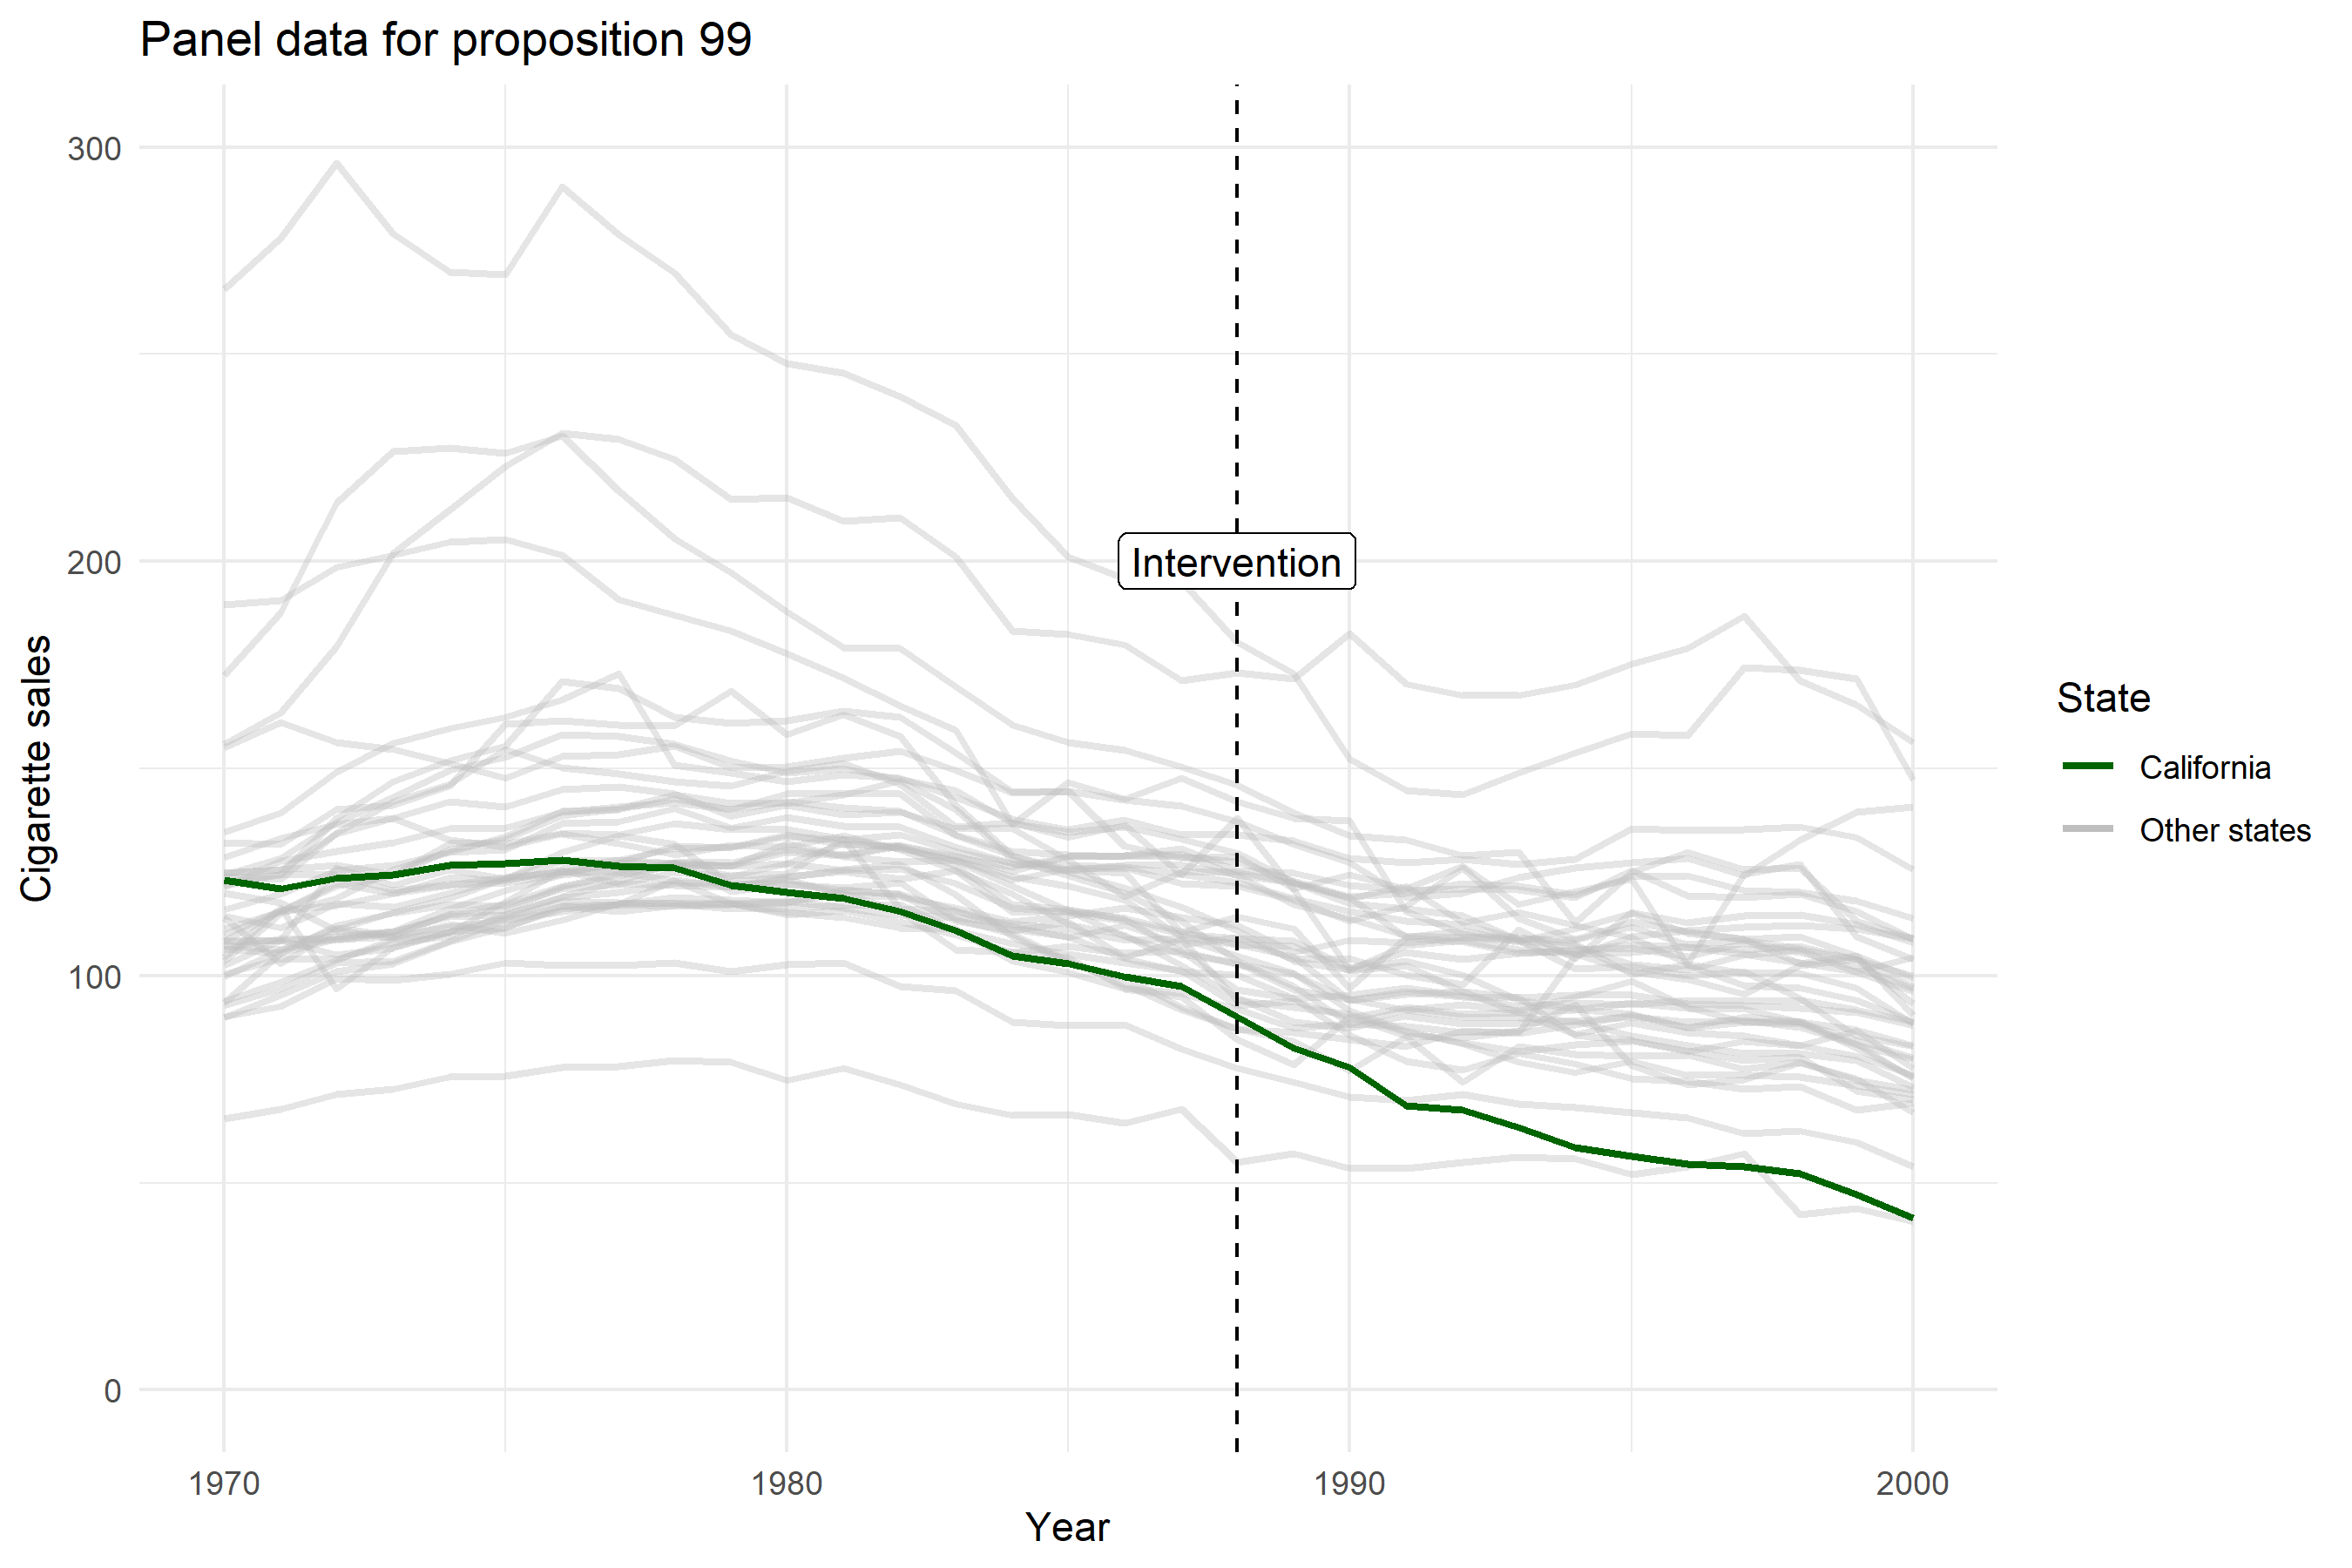

Slide 11
Methods for Policy Evaluation
Many different methods have been developed to answer these types of research questions
Differing in:
The amount and type of information they use
Number of time-points and potential “control” units
The specific statistical approach they take
The types of assumptions they make

Slide 12
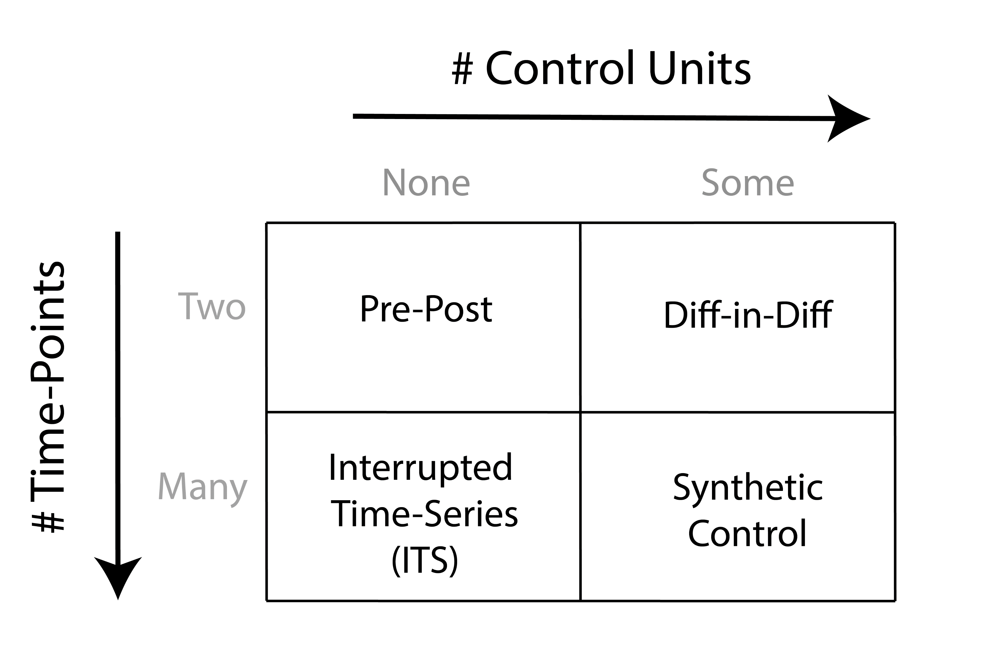

Slide 13
Causal Inference: A primer

Slide 14
Potential Outcomes
Causal inference is (broadly) concerned with using data to estimate what the effect is of intervening or changing the value of one or more variables.
Using the potential outcomes framework, we can define causal inference as a missing data problem

Slide 15



Slide 16
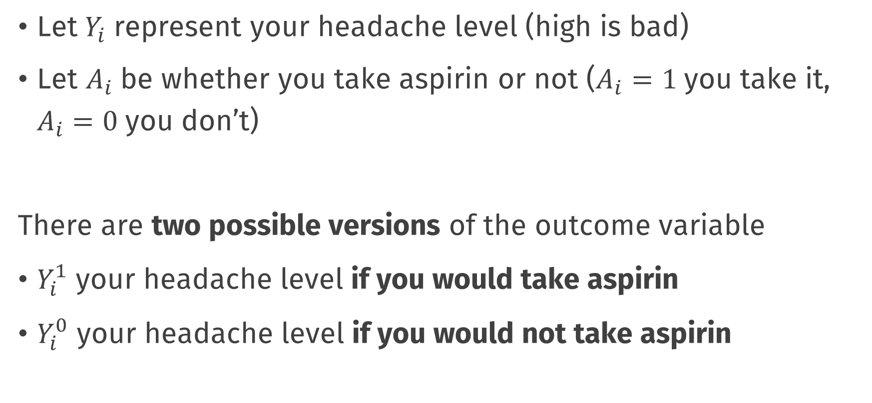
Potential Outcomes: notation
Let $Y_{i}$ represent your headache level (high is bad)
Let $A_{i}$ be whether you take aspirin or not ($A_{i}=1$you take it, $A_{i}=0$you don’t)
There are two possible versions of the outcome variable
$Y_{i}^{1}$ your headache level if you would take aspirin
$Y_{i}^{0}$ your headache level if you would not take aspirin

Slide 17
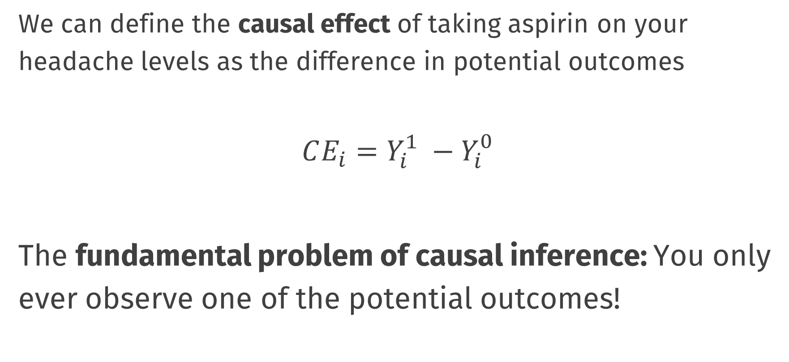
Causal Effects
We can define the causal effect of taking aspirin on your headache levels as the difference in potential outcomes
$$CE_{i}=Y_{i}^{1} −Y_{i}^{0}$$
The fundamental problem of causal inference: You only ever observe one of the potential outcomes!

Slide 18
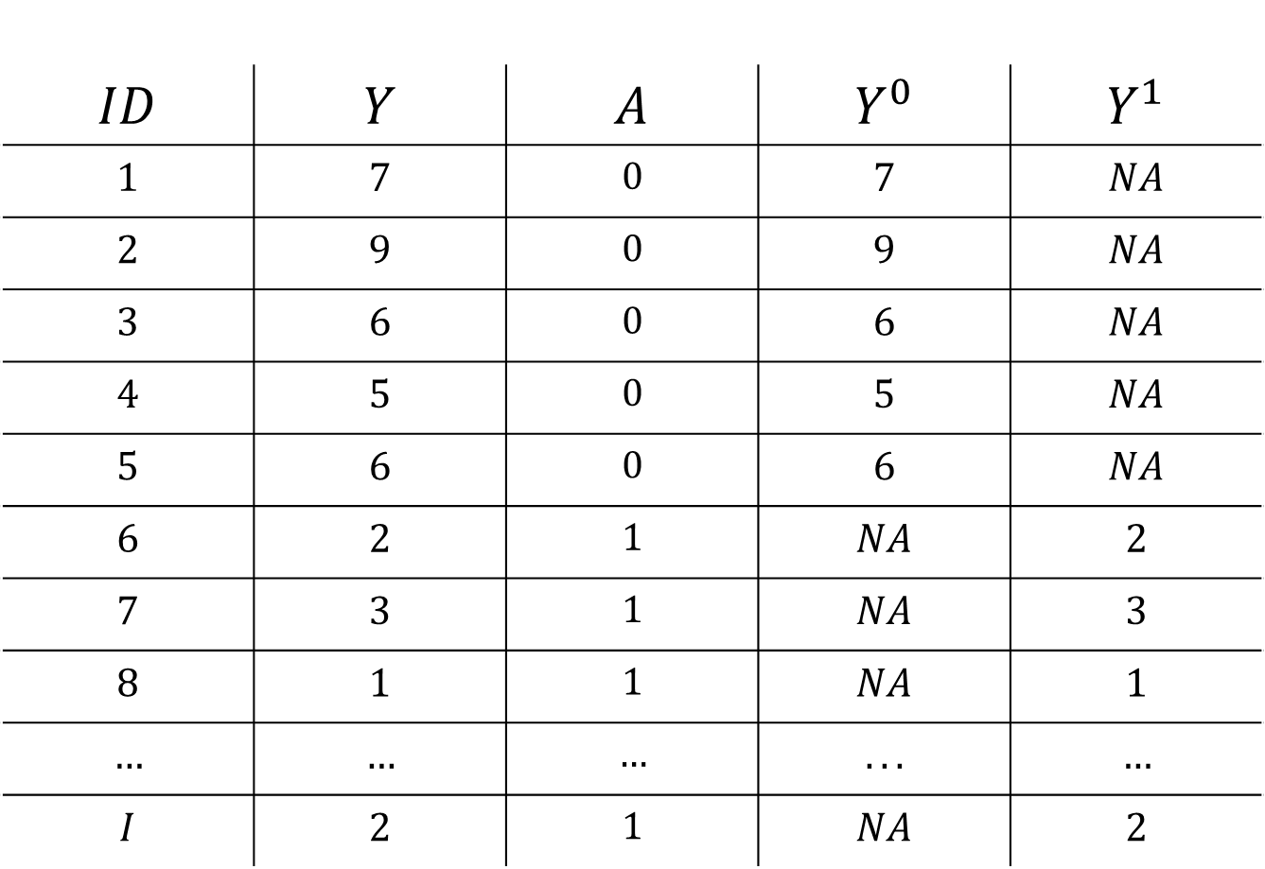
Data and Potential Outcomes
$$ID$$ | $$Y$$ | $$A$$ | $$Y^{0}$$ | $$Y^{1}$$
$$1$$ | $$7$$ | $$0$$ | $$7$$ | $$NA$$
$$2$$ | $$9$$ | $$0$$ | $$9$$ | $$NA$$
$$3$$ | $$6$$ | $$0$$ | $$6$$ | $$NA$$
$$4$$ | $$5$$ | $$0$$ | $$5$$ | $$NA$$
$$5$$ | $$6$$ | $$0$$ | $$6$$ | $$NA$$
$$6$$ | $$2$$ | $$1$$ | $$NA$$ | $$2$$
$$7$$ | $$3$$ | $$1$$ | $$NA$$ | $$3$$
$$8$$ | $$1$$ | $$1$$ | $$NA$$ | $$1$$
$$…$$ | $$…$$ | $$…$$ | $$...$$ | $$…$$
$$I$$ | $$2$$ | $$1$$ | $$NA$$ | $$2$$

Slide 19
Data and Potential Outcomes
$$ID$$ | $$Y$$ | $$A$$ | $$Y^{0}$$ | $$Y^{1}$$
$$1$$ | $$7$$ | $$0$$ | $$7$$ | $$NA$$
$$2$$ | $$9$$ | $$0$$ | $$9$$ | $$NA$$
$$3$$ | $$6$$ | $$0$$ | $$6$$ | $$NA$$
$$4$$ | $$5$$ | $$0$$ | $$5$$ | $$NA$$
$$5$$ | $$6$$ | $$0$$ | $$6$$ | $$NA$$
$$6$$ | $$2$$ | $$1$$ | $$NA$$ | $$2$$
$$7$$ | $$3$$ | $$1$$ | $$NA$$ | $$3$$
$$8$$ | $$1$$ | $$1$$ | $$NA$$ | $$1$$
$$…$$ | $$…$$ | $$…$$ | $$...$$ | $$…$$
$$I$$ | $$2$$ | $$1$$ | $$NA$$ | $$2$$

Slide 20
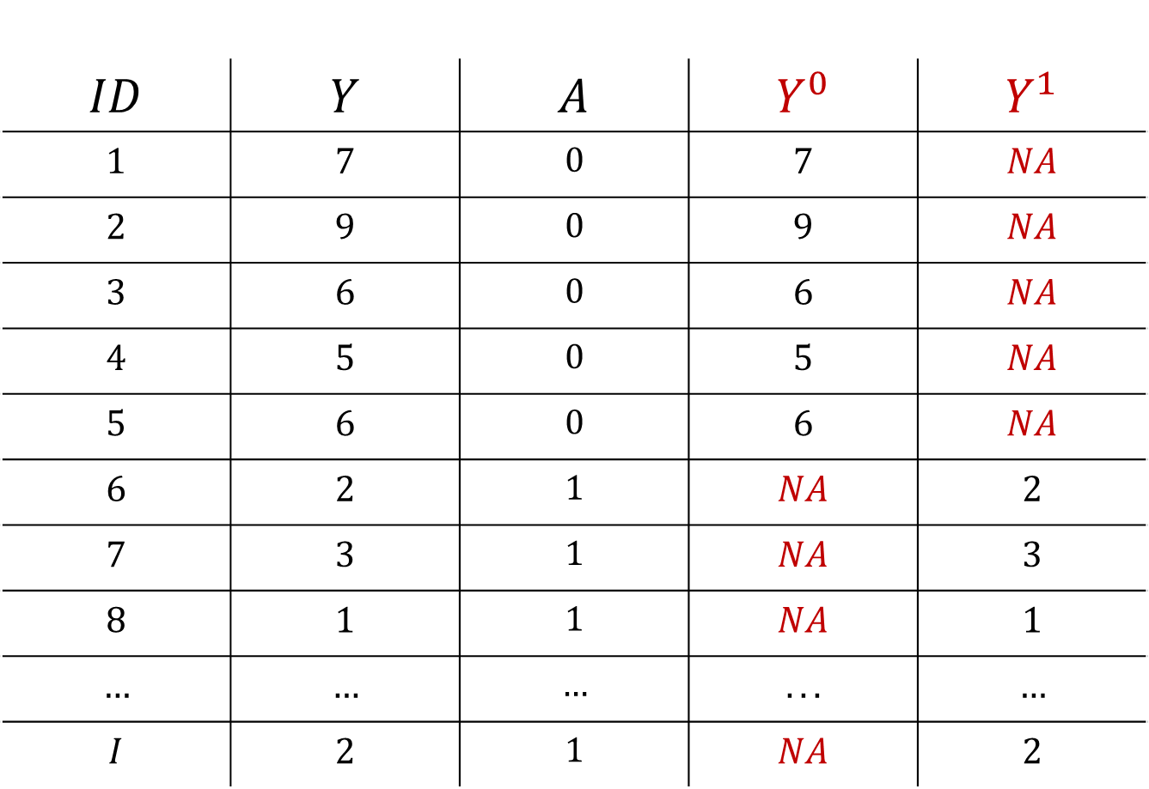
Data and Potential Outcomes
$$ID$$ | $$Y$$ | $$A$$ | $$Y^{0}$$ | $$Y^{1}$$
$$1$$ | $$7$$ | $$0$$ | $$7$$ | $$NA$$
$$2$$ | $$9$$ | $$0$$ | $$9$$ | $$NA$$
$$3$$ | $$6$$ | $$0$$ | $$6$$ | $$NA$$
$$4$$ | $$5$$ | $$0$$ | $$5$$ | $$NA$$
$$5$$ | $$6$$ | $$0$$ | $$6$$ | $$NA$$
$$6$$ | $$2$$ | $$1$$ | $$NA$$ | $$2$$
$$7$$ | $$3$$ | $$1$$ | $$NA$$ | $$3$$
$$8$$ | $$1$$ | $$1$$ | $$NA$$ | $$1$$
$$…$$ | $$…$$ | $$…$$ | $$...$$ | $$…$$
$$I$$ | $$2$$ | $$1$$ | $$NA$$ | $$2$$

Slide 21
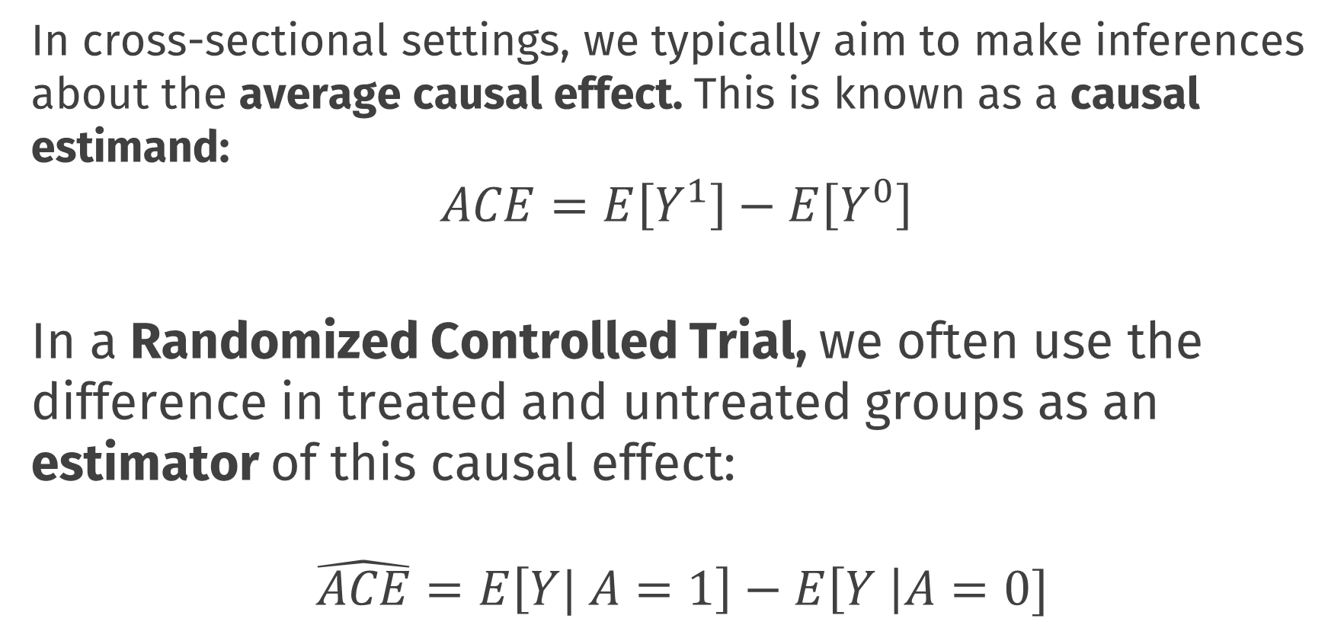
Causal Inference
In cross-sectional settings, we typically aim to make inferences about the average causal effect. This is known as a causal estimand:
$$ACE=E\left[Y^{1}\right]−E\left[Y^{0}\right]$$ In a Randomized Controlled Trial, we often use the difference in treated and untreated groups as an estimator of this causal effect:
$$\hat{ACE}=E\left[Y| A=1\right]−E\left[Y \right|A=0]$$
Notes:
Even though we can’t directly observe both $Y_{i}^{1}$ and $Y_{i}^{0}$ for the same individuals, under certain conditions, we can make inferences about these potential outcome variables

Slide 22
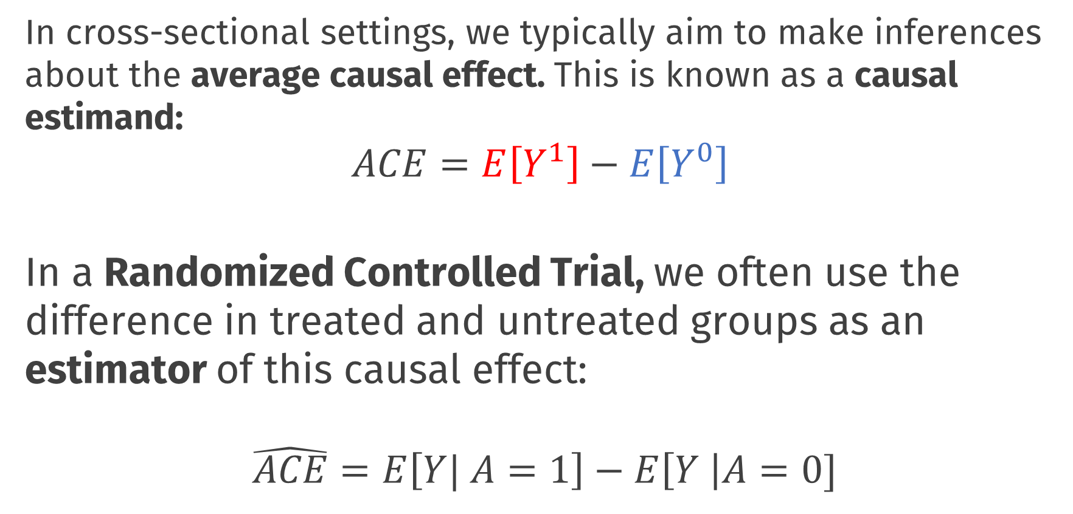
Causal Inference
In cross-sectional settings, we typically aim to make inferences about the average causal effect. This is known as a causal estimand:
$$ACE=E\left[Y^{1}\right]−E\left[Y^{0}\right]$$ In a Randomized Controlled Trial, we often use the difference in treated and untreated groups as an estimator of this causal effect:
$$\hat{ACE}=E\left[Y| A=1\right]−E\left[Y \right|A=0]$$
Notes:
Even though we can’t directly observe both $Y_{i}^{1}$ and $Y_{i}^{0}$ for the same individuals, under certain conditions, we can make inferences about these potential outcome variables

Slide 23
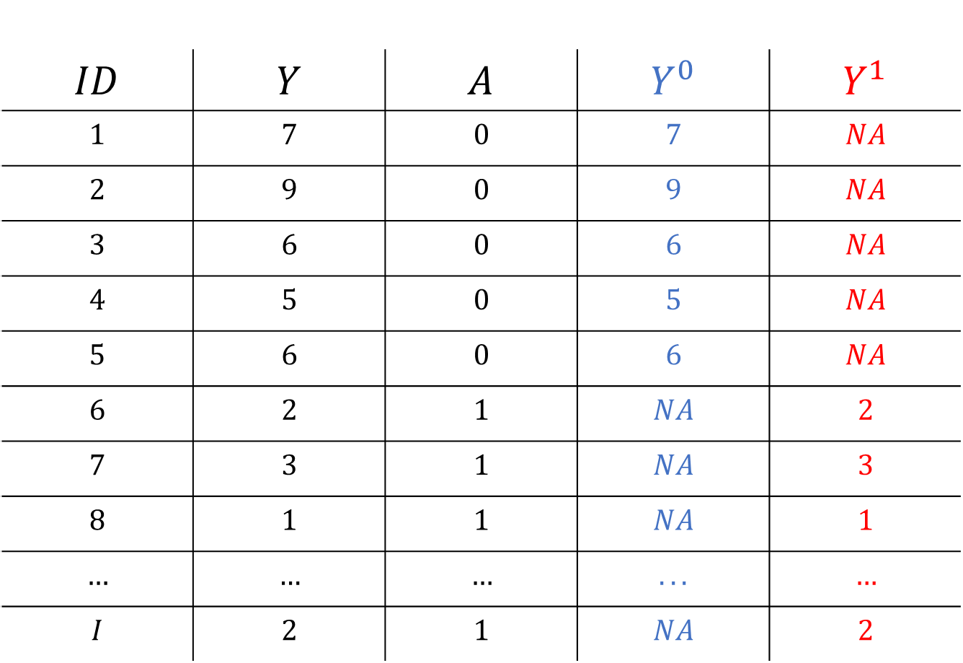
Causal Inference
$$ID$$ | $$Y$$ | $$A$$ | $$Y^{0}$$ | $$Y^{1}$$
$$1$$ | $$7$$ | $$0$$ | $$7$$ | $$NA$$
$$2$$ | $$9$$ | $$0$$ | $$9$$ | $$NA$$
$$3$$ | $$6$$ | $$0$$ | $$6$$ | $$NA$$
$$4$$ | $$5$$ | $$0$$ | $$5$$ | $$NA$$
$$5$$ | $$6$$ | $$0$$ | $$6$$ | $$NA$$
$$6$$ | $$2$$ | $$1$$ | $$NA$$ | $$2$$
$$7$$ | $$3$$ | $$1$$ | $$NA$$ | $$3$$
$$8$$ | $$1$$ | $$1$$ | $$NA$$ | $$1$$
$$…$$ | $$…$$ | $$…$$ | $$...$$ | $$…$$
$$I$$ | $$2$$ | $$1$$ | $$NA$$ | $$2$$

Slide 24
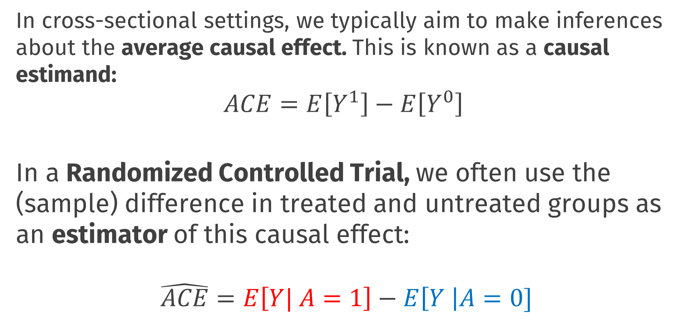
Causal Inference
In cross-sectional settings, we typically aim to make inferences about the average causal effect. This is known as a causal estimand:
$$ACE=E\left[Y^{1}\right]−E\left[Y^{0}\right]$$ In a Randomized Controlled Trial, we often use the (sample) difference in treated and untreated groups as an estimator of this causal effect:
$$\hat{ACE}=E\left[Y| A=1\right]−E\left[Y \right|A=0]$$

Slide 25
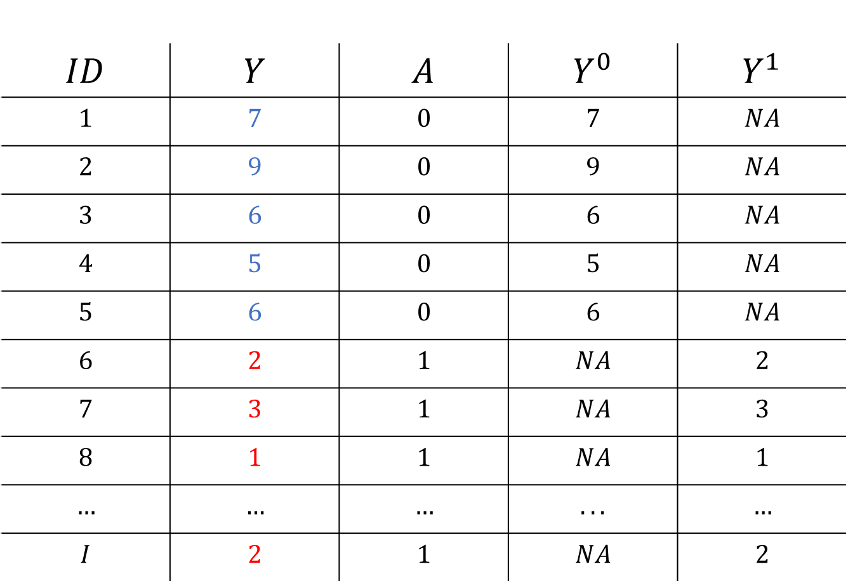
Causal Inference
$$ID$$ | $$Y$$ | $$A$$ | $$Y^{0}$$ | $$Y^{1}$$
$$1$$ | $$7$$ | $$0$$ | $$7$$ | $$NA$$
$$2$$ | $$9$$ | $$0$$ | $$9$$ | $$NA$$
$$3$$ | $$6$$ | $$0$$ | $$6$$ | $$NA$$
$$4$$ | $$5$$ | $$0$$ | $$5$$ | $$NA$$
$$5$$ | $$6$$ | $$0$$ | $$6$$ | $$NA$$
$$6$$ | $$2$$ | $$1$$ | $$NA$$ | $$2$$
$$7$$ | $$3$$ | $$1$$ | $$NA$$ | $$3$$
$$8$$ | $$1$$ | $$1$$ | $$NA$$ | $$1$$
$$…$$ | $$…$$ | $$…$$ | $$...$$ | $$…$$
$$I$$ | $$2$$ | $$1$$ | $$NA$$ | $$2$$

Slide 26
Causal Inference Assumptions
This type of inference about causal effects from observed data is only possible under certain conditions or assumptions
Exchangeability
If we were to reverse treatment assignment we would observe the same group differences. Information is exchangeable between groups
Basically: absence of confounder variables
E.g., People who have bad headaches choose to take the aspirin
RCTs are powerful because randomization ensures exchangeability. But in principle this kind of inference is possible from non-RCT designs
In practice we need conditional exchangeability; to control for confounders!

Slide 27
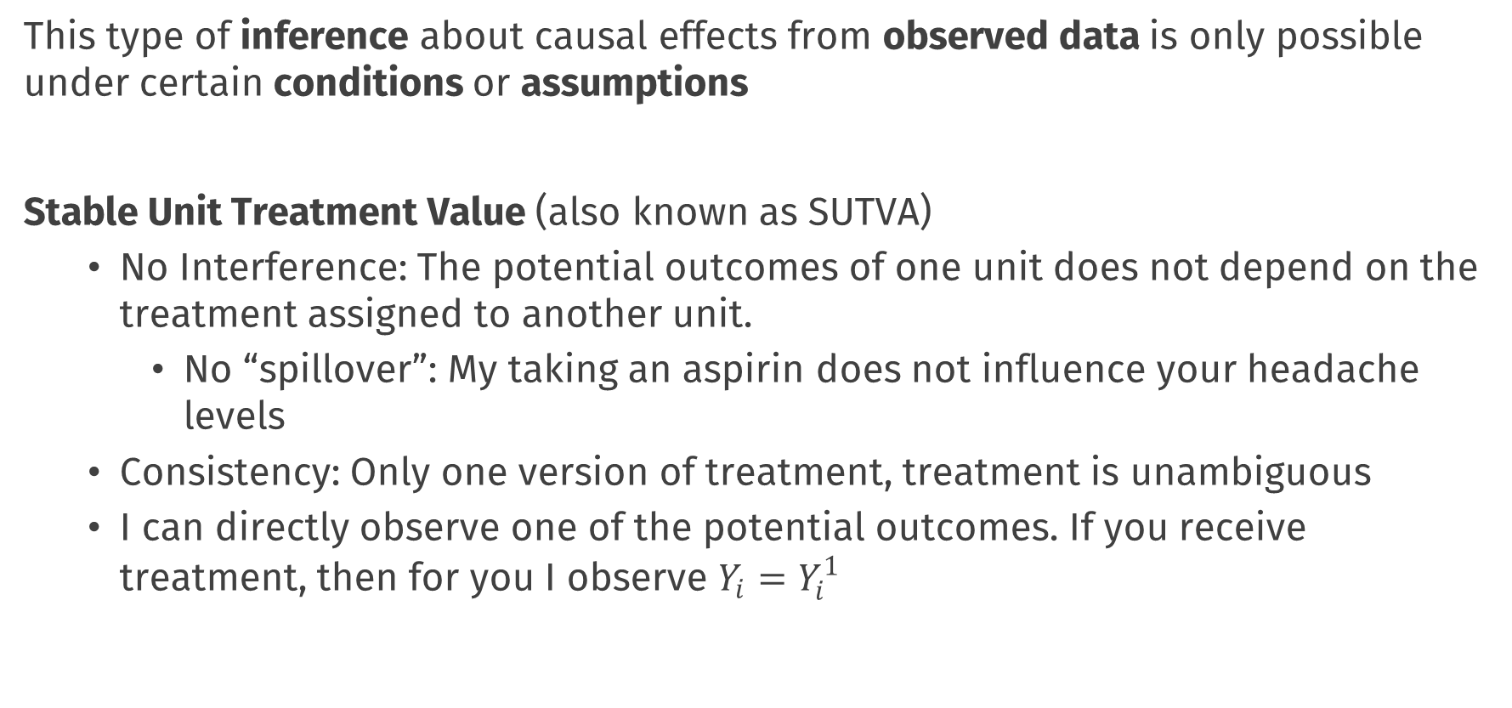
Causal Inference Assumptions
This type of inference about causal effects from observed data is only possible under certain conditions or assumptions
Stable Unit Treatment Value (also known as SUTVA)
No Interference: The potential outcomes of one unit does not depend on the treatment assigned to another unit.
No “spillover”: My taking an aspirin does not influence your headache levels
Consistency: Only one version of treatment, treatment is unambiguous
I can directly observe one of the potential outcomes. If you receive treatment, then for you I observe $Y_{i}=Y_{i}^{1}$
Notes:
E.g.: If I want to make inferences about the effect of losing weight on heart health, my inferences will be different if I study people who gradually lost weight due to diet and exercise vs those who are lighter due to liposuction

Slide 28
Causal Inference Assumptions
These two often appear in causal inference
Need to deal with confounders and no interference
NB:
Other assumptions or conditions may also be needed
Depends on design and analytic approach you take

Slide 29
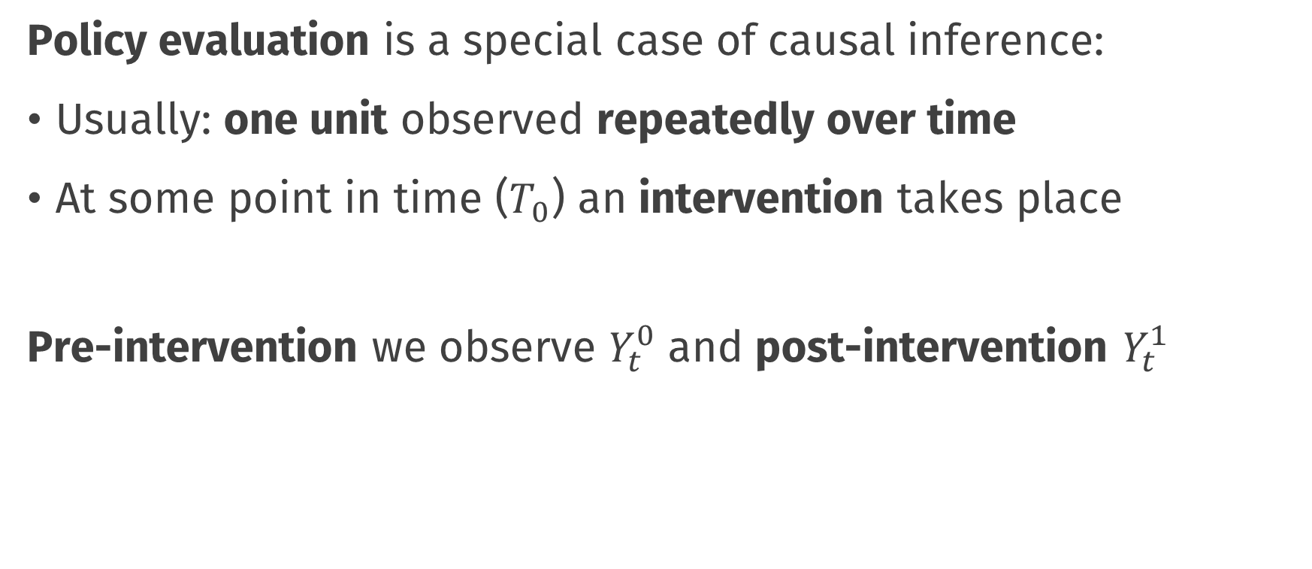
Causal inference for policies
Policy evaluation is a special case of causal inference:
Usually: one unit observed repeatedly over time
At some point in time ($T_{0}$) an intervention takes place
Pre-intervention we observe $Y_{t}^{0}$ and post-intervention $Y_{t}^{1}$

Slide 30
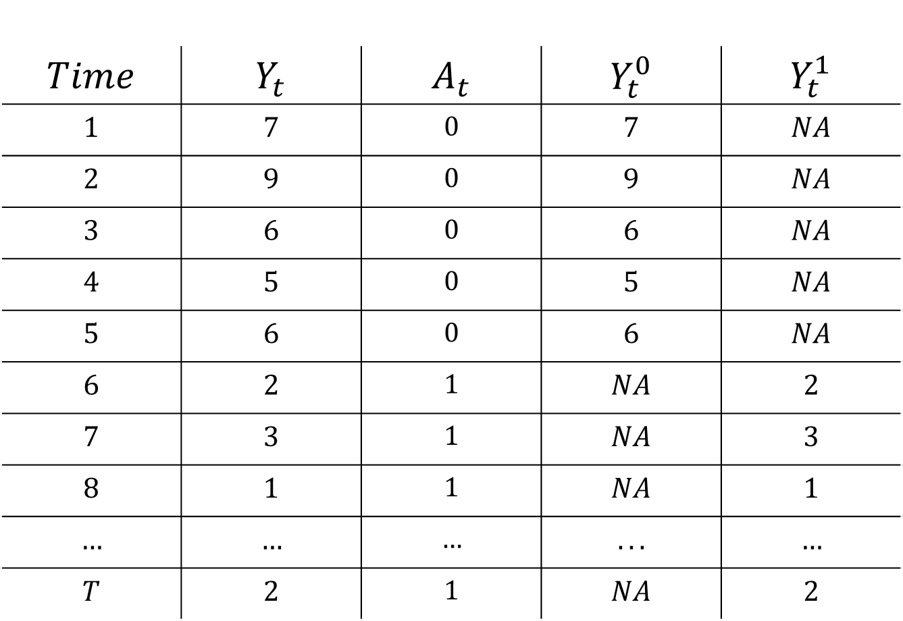
$$Time$$ | $$Y_{t}$$ | $$A_{t}$$ | $$Y_{t}^{0}$$ | $$Y_{t}^{1}$$
$$1$$ | $$7$$ | $$0$$ | $$7$$ | $$NA$$
$$2$$ | $$9$$ | $$0$$ | $$9$$ | $$NA$$
$$3$$ | $$6$$ | $$0$$ | $$6$$ | $$NA$$
$$4$$ | $$5$$ | $$0$$ | $$5$$ | $$NA$$
$$5$$ | $$6$$ | $$0$$ | $$6$$ | $$NA$$
$$6$$ | $$2$$ | $$1$$ | $$NA$$ | $$2$$
$$7$$ | $$3$$ | $$1$$ | $$NA$$ | $$3$$
$$8$$ | $$1$$ | $$1$$ | $$NA$$ | $$1$$
$$…$$ | $$…$$ | $$…$$ | $$...$$ | $$…$$
$$T$$ | $$2$$ | $$1$$ | $$NA$$ | $$2$$

Slide 31
$$Time$$ | $$Y_{t}$$ | $$A_{t}$$ | $$Y_{t}^{0}$$ | $$Y_{t}^{1}$$
$$1$$ | $$7$$ | $$0$$ | $$7$$ | $$NA$$
$$2$$ | $$9$$ | $$0$$ | $$9$$ | $$NA$$
$$3$$ | $$6$$ | $$0$$ | $$6$$ | $$NA$$
$$4$$ | $$5$$ | $$0$$ | $$5$$ | $$NA$$
$$5$$ | $$6$$ | $$0$$ | $$6$$ | $$NA$$
$$6$$ | $$2$$ | $$1$$ | $$NA$$ | $$2$$
$$7$$ | $$3$$ | $$1$$ | $$NA$$ | $$3$$
$$8$$ | $$1$$ | $$1$$ | $$NA$$ | $$1$$
$$…$$ | $$…$$ | $$…$$ | $$...$$ | $$…$$
$$T$$ | $$2$$ | $$1$$ | $$NA$$ | $$2$$

Slide 32
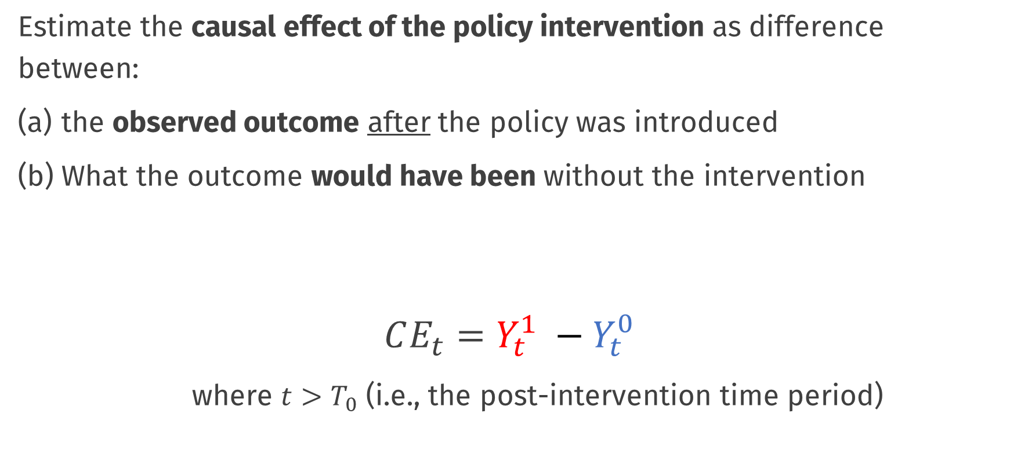
Causal Effects of Policies
Estimate the causal effect of the policy intervention as difference between:
the observed outcome after the policy was introduced
What the outcome would have been without the intervention
$$CE_{t}=Y_{t}^{1} −Y_{t}^{0}$$
where $t>T_{0}$ (i.e., the post-intervention time period)

Slide 33
$$Time$$ | $$Y_{t}$$ | $$A_{t}$$ | $$Y_{t}^{0}$$ | $$Y_{t}^{1}$$
$$1$$ | $$7$$ | $$0$$ | $$7$$ | $$NA$$
$$2$$ | $$9$$ | $$0$$ | $$9$$ | $$NA$$
$$3$$ | $$6$$ | $$0$$ | $$6$$ | $$NA$$
$$4$$ | $$5$$ | $$0$$ | $$5$$ | $$NA$$
$$5$$ | $$6$$ | $$0$$ | $$6$$ | $$NA$$
$$6$$ | $$2$$ | $$1$$ | $$NA$$ | $$2$$
$$7$$ | $$3$$ | $$1$$ | $$NA$$ | $$3$$
$$8$$ | $$1$$ | $$1$$ | $$NA$$ | $$1$$
$$…$$ | $$…$$ | $$…$$ | $$...$$ | $$…$$
$$T$$ | $$2$$ | $$1$$ | $$NA$$ | $$2$$

Slide 34
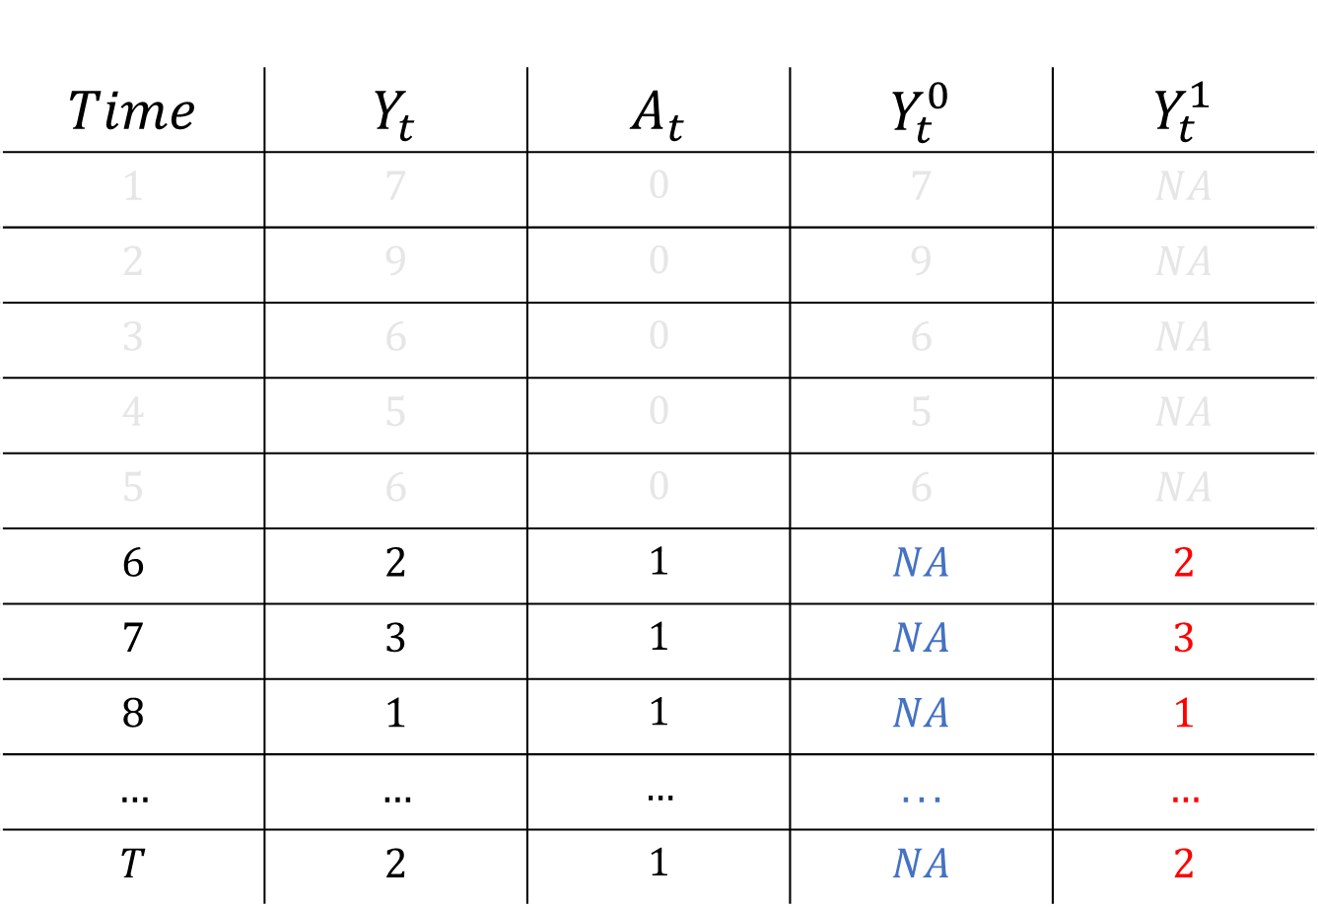
$$Time$$ | $$Y_{t}$$ | $$A_{t}$$ | $$Y_{t}^{0}$$ | $$Y_{t}^{1}$$
$$1$$ | $$7$$ | $$0$$ | $$7$$ | $$NA$$
$$2$$ | $$9$$ | $$0$$ | $$9$$ | $$NA$$
$$3$$ | $$6$$ | $$0$$ | $$6$$ | $$NA$$
$$4$$ | $$5$$ | $$0$$ | $$5$$ | $$NA$$
$$5$$ | $$6$$ | $$0$$ | $$6$$ | $$NA$$
$$6$$ | $$2$$ | $$1$$ | $$NA$$ | $$2$$
$$7$$ | $$3$$ | $$1$$ | $$NA$$ | $$3$$
$$8$$ | $$1$$ | $$1$$ | $$NA$$ | $$1$$
$$…$$ | $$…$$ | $$…$$ | $$...$$ | $$…$$
$$T$$ | $$2$$ | $$1$$ | $$NA$$ | $$2$$

Slide 35
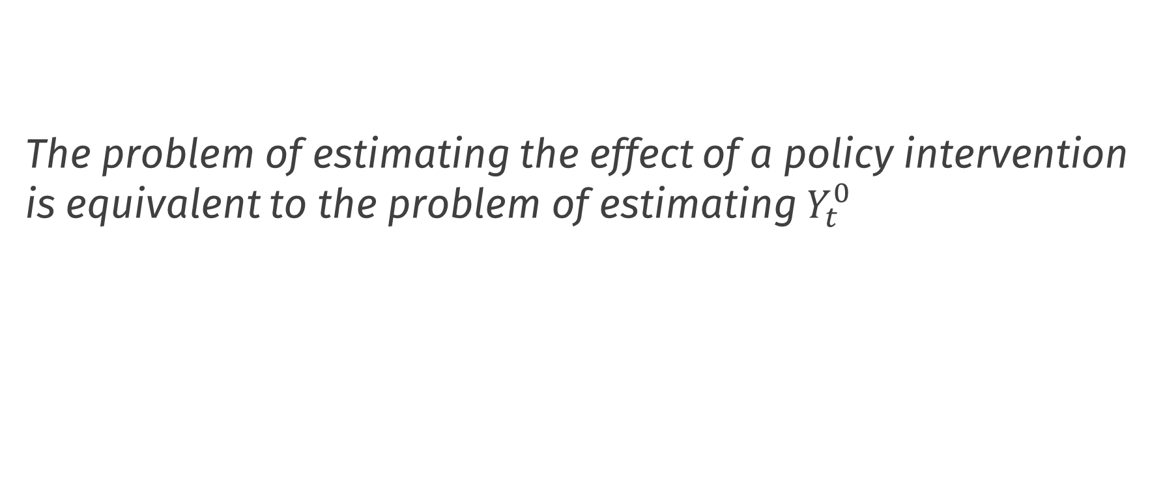
The problem of estimating the effect of a policy intervention is equivalent to the problem of estimating $Y_{t}^{0}$
Abadie, A. (2021). Using synthetic controls: Feasibility, data requirements, and methodological aspects. Journal of Economic Literature, 59(2), 391-425.

Slide 36
Estimating the causal effect
Basic methods

Slide 37
Pre-Post Estimator

Slide 38
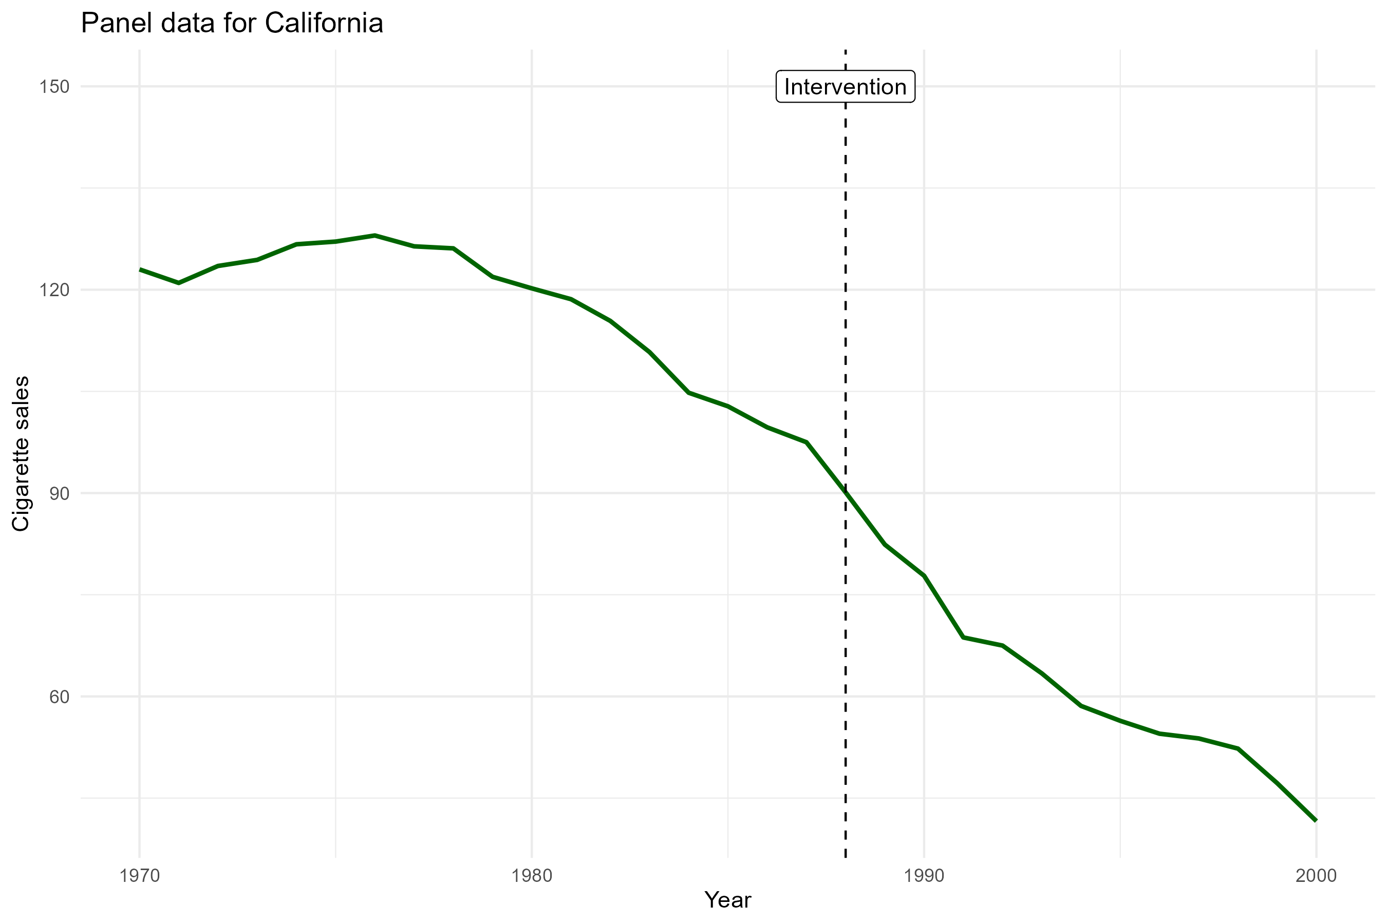
Pre-post estimator
We use only the cigarette sales time series for California

Slide 39
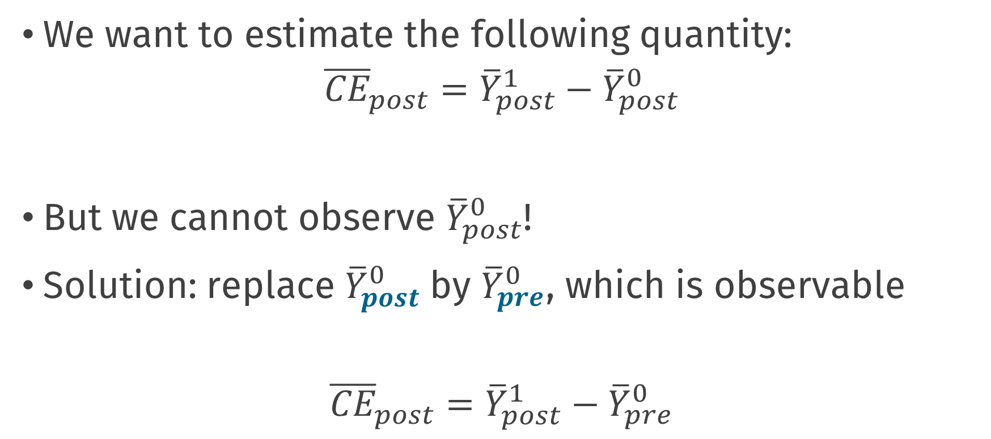
Pre-post estimator
We want to estimate the following quantity:
$${\overline{CE}}_{post}={\overline{Y}}_{post}^{1}−{\overline{Y}}_{post}^{0}$$
But we cannot observe ${\overline{Y}}_{post}^{0}$!
Solution: replace ${\overline{Y}}_{post}^{0}$by ${\overline{Y}}_{pre}^{0}$, which is observable
$${\overline{CE}}_{post}={\overline{Y}}_{post}^{1}−{\overline{Y}}_{pre}^{0}$$

Slide 40
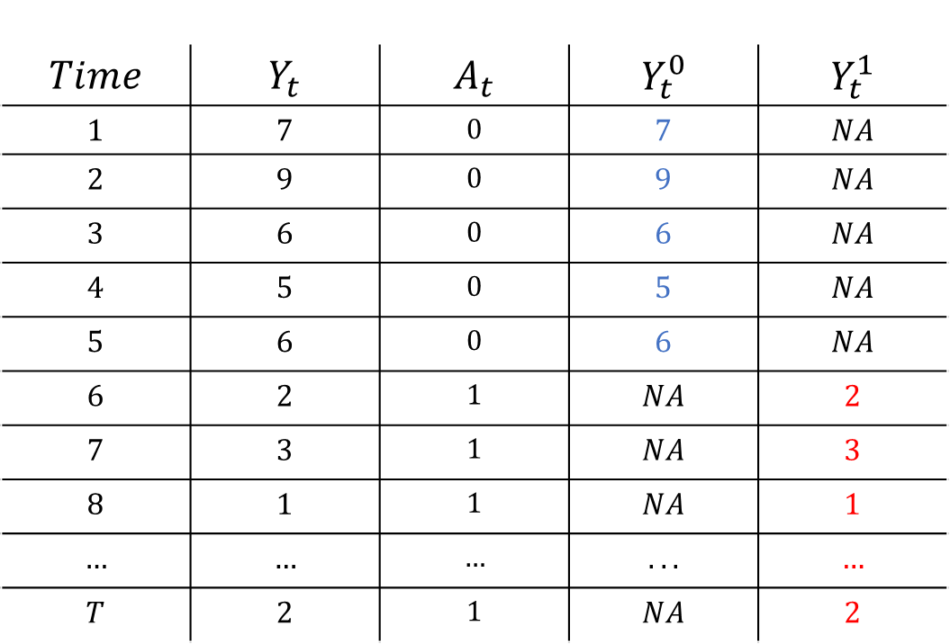
Pre – Post analysis
$$Time$$ | $$Y_{t}$$ | $$A_{t}$$ | $$Y_{t}^{0}$$ | $$Y_{t}^{1}$$
$$1$$ | $$7$$ | $$0$$ | $$7$$ | $$NA$$
$$2$$ | $$9$$ | $$0$$ | $$9$$ | $$NA$$
$$3$$ | $$6$$ | $$0$$ | $$6$$ | $$NA$$
$$4$$ | $$5$$ | $$0$$ | $$5$$ | $$NA$$
$$5$$ | $$6$$ | $$0$$ | $$6$$ | $$NA$$
$$6$$ | $$2$$ | $$1$$ | $$NA$$ | $$2$$
$$7$$ | $$3$$ | $$1$$ | $$NA$$ | $$3$$
$$8$$ | $$1$$ | $$1$$ | $$NA$$ | $$1$$
$$…$$ | $$…$$ | $$…$$ | $$...$$ | $$…$$
$$T$$ | $$2$$ | $$1$$ | $$NA$$ | $$2$$
$${\overline{Y}}_{pre}^{0}$$
$${\overline{Y}}_{post}^{1}$$

Slide 41

Pre – Post analysis
$$Time$$ | $$Y_{t}$$ | $$A_{t}$$ | $$Y_{t}^{0}$$ | $$Y_{t}^{1}$$
$$1$$ | $$7$$ | $$0$$ | $$7$$ | $$NA$$
$$2$$ | $$9$$ | $$0$$ | $$9$$ | $$NA$$
$$3$$ | $$6$$ | $$0$$ | $$6$$ | $$NA$$
$$4$$ | $$5$$ | $$0$$ | $$5$$ | $$NA$$
$$5$$ | $$6$$ | $$0$$ | $$6$$ | $$NA$$
$$6$$ | $$2$$ | $$1$$ | $$NA$$ | $$2$$
$$7$$ | $$3$$ | $$1$$ | $$NA$$ | $$3$$
$$8$$ | $$1$$ | $$1$$ | $$NA$$ | $$1$$
$$…$$ | $$…$$ | $$…$$ | $$...$$ | $$…$$
$$T$$ | $$2$$ | $$1$$ | $$NA$$ | $$2$$
$${\overline{Y}}_{pre}^{0}$$
Assume equal to
$${\overline{Y}}_{post}^{1}$$
$${ − \overline{Y}}_{post}^{0}$$
$${\overline{CE}}_{post}={\overline{Y}}_{post}^{1}−{\overline{Y}}_{post}^{0}$$

Slide 42
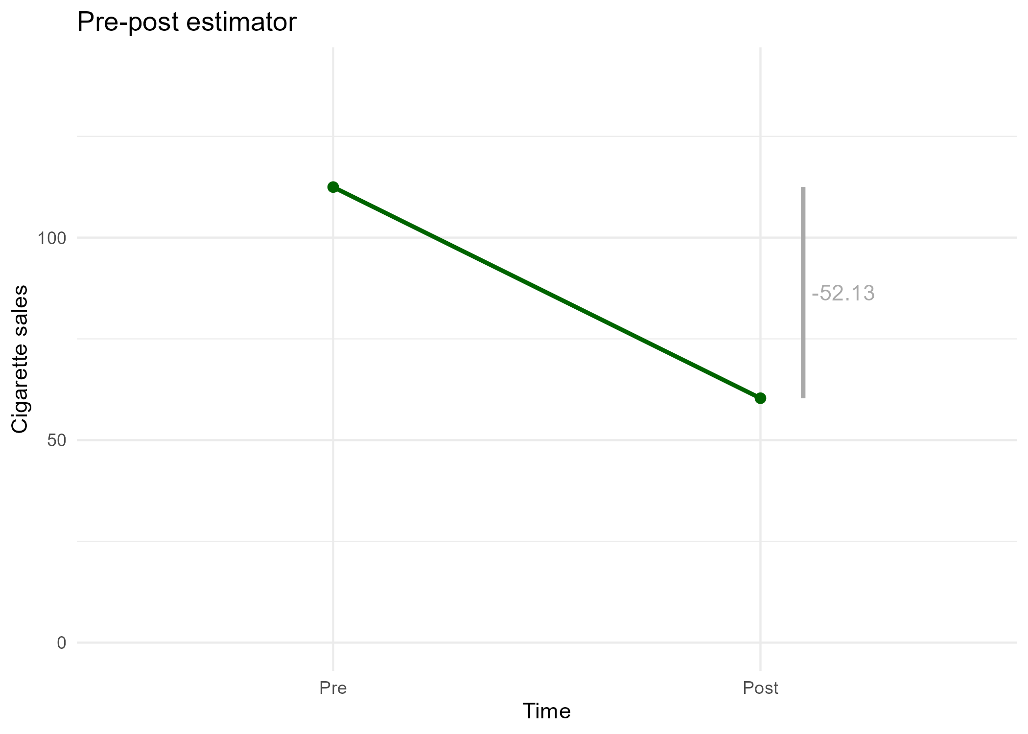
Pre-post estimator

Slide 43
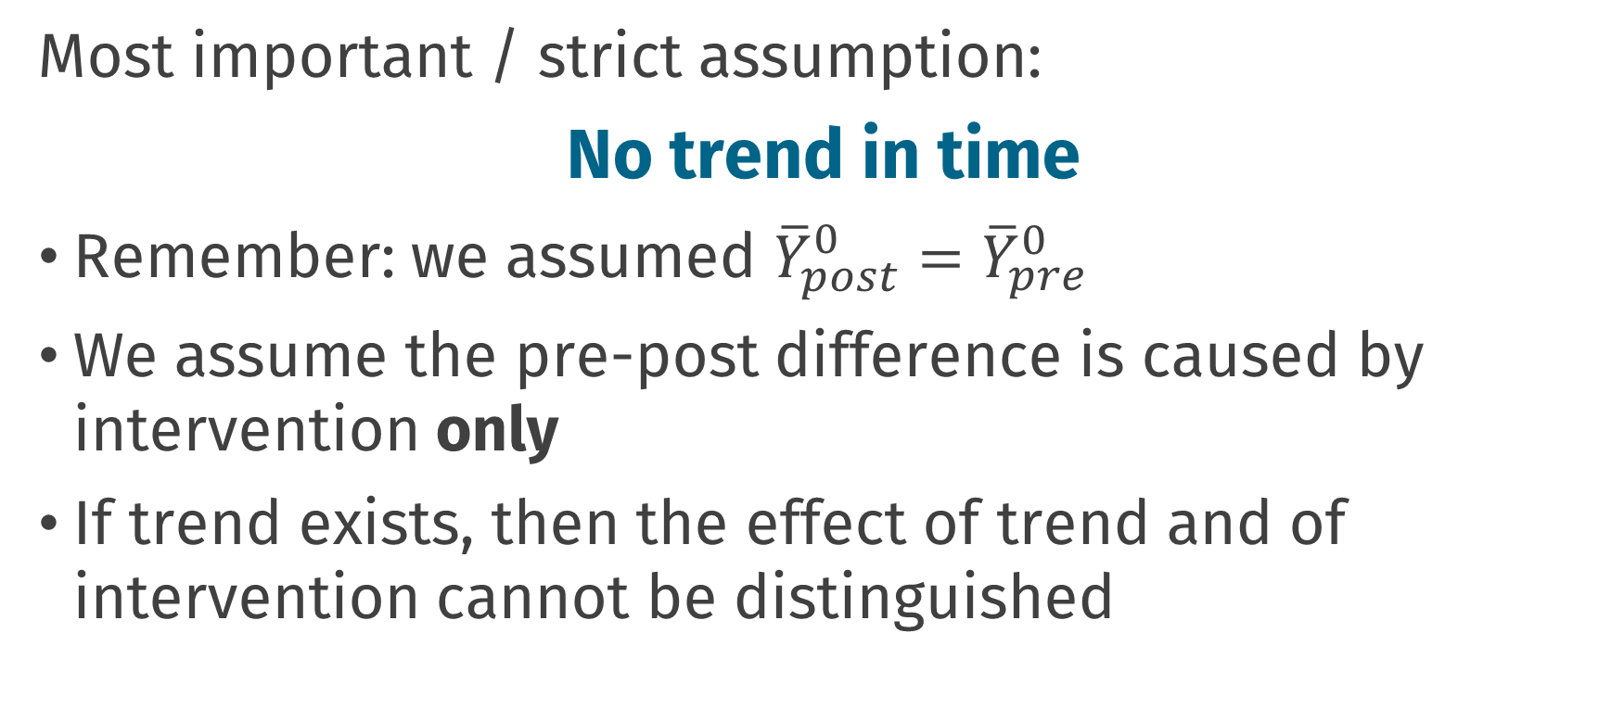
Pre-post estimator
Most important / strict assumption:
No trend in time
Remember: we assumed ${\overline{Y}}_{post}^{0}={\overline{Y}}_{pre}^{0}$
We assume the pre-post difference is caused by intervention only
If trend exists, then the effect of trend and of intervention cannot be distinguished

Slide 44
Pre-post estimator
Is there a trend in time, independent of the intervention?
How much of pre-post difference is caused by intervention?

Slide 45
Difference-in-Differences

Slide 46
Difference-in-differences
,,transparent and often at least superficially plausible”
Used a lot in economics
There is a lot of discussion around this topic
We will explain the basic method here
There are a lot of possible extensions!
Angrist, J. D. and Krueger, A. B. (1999). Empirical strategies in labor economics. In Handbook of labor economics, volume 3, pages 1277–1366. Elsevier.

Slide 47
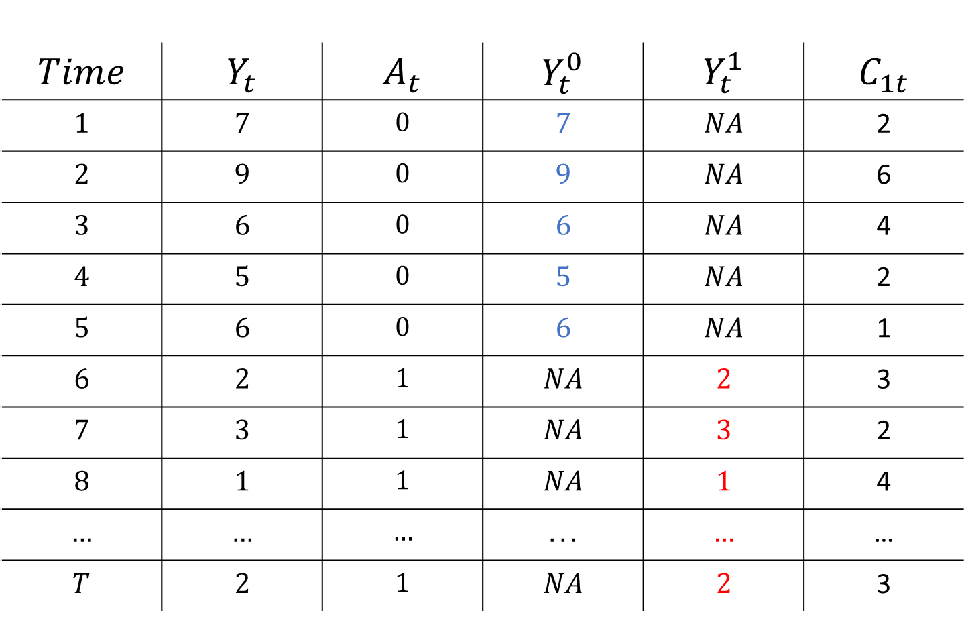
$$Time$$ | $$Y_{t}$$ | $$A_{t}$$ | $$Y_{t}^{0}$$ | $$Y_{t}^{1}$$ | $$C_{1t}$$
$$1$$ | $$7$$ | $$0$$ | $$7$$ | $$NA$$ | 2
$$2$$ | $$9$$ | $$0$$ | $$9$$ | $$NA$$ | 6
$$3$$ | $$6$$ | $$0$$ | $$6$$ | $$NA$$ | 4
$$4$$ | $$5$$ | $$0$$ | $$5$$ | $$NA$$ | 2
$$5$$ | $$6$$ | $$0$$ | $$6$$ | $$NA$$ | 1
$$6$$ | $$2$$ | $$1$$ | $$NA$$ | $$2$$ | 3
$$7$$ | $$3$$ | $$1$$ | $$NA$$ | $$3$$ | 2
$$8$$ | $$1$$ | $$1$$ | $$NA$$ | $$1$$ | 4
$$…$$ | $$…$$ | $$…$$ | $$...$$ | $$…$$ | …
$$T$$ | $$2$$ | $$1$$ | $$NA$$ | $$2$$ | 3

Slide 48
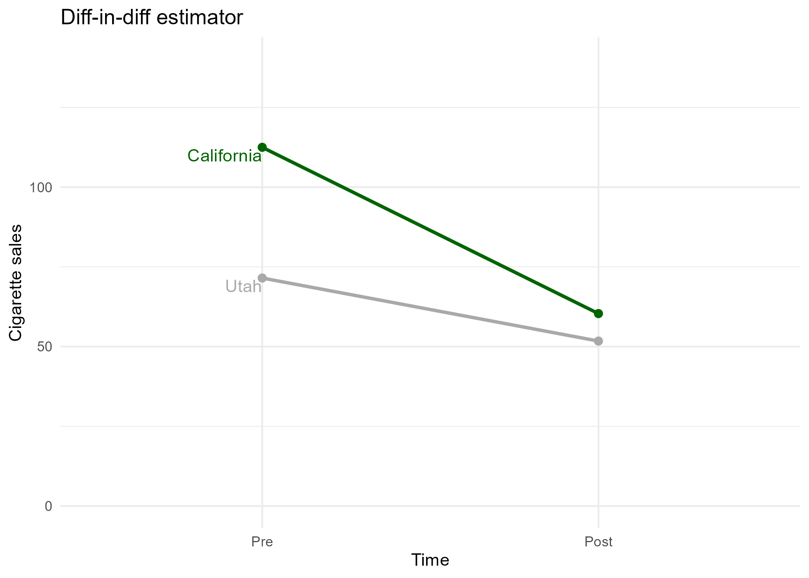
Difference-in-differences

Slide 49
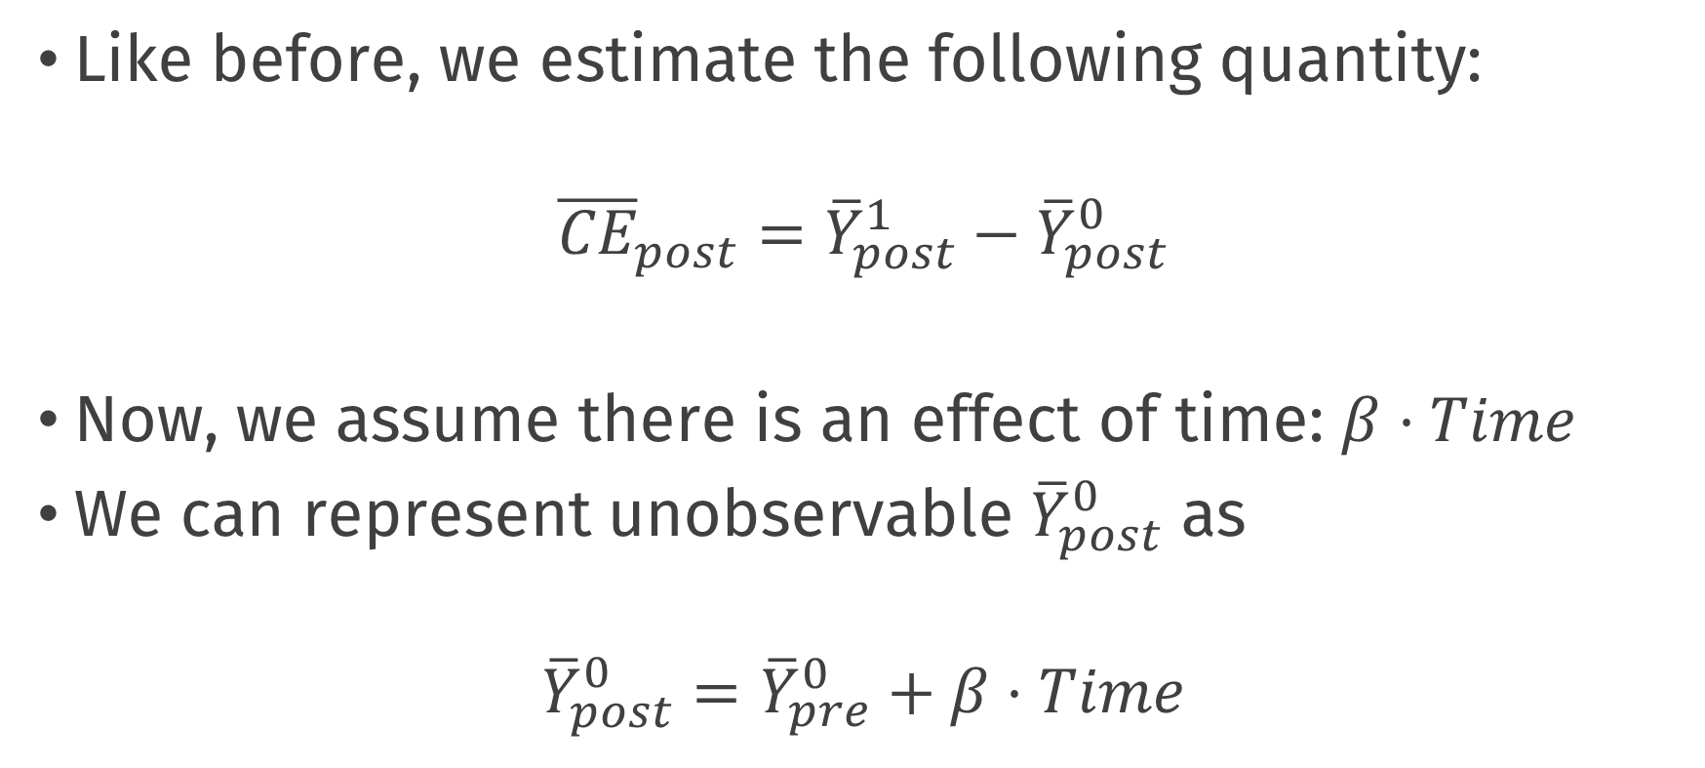
Pre-post estimator
Like before, we estimate the following quantity:
$${\overline{CE}}_{post}={\overline{Y}}_{post}^{1}−{\overline{Y}}_{post}^{0}$$
Now, we assume there is an effect of time: $β⋅Time$
We can represent unobservable ${\overline{Y}}_{post}^{0}$ as
$${\overline{Y}}_{post}^{0}={\overline{Y}}_{pre}^{0}+β⋅Time$$

Slide 50
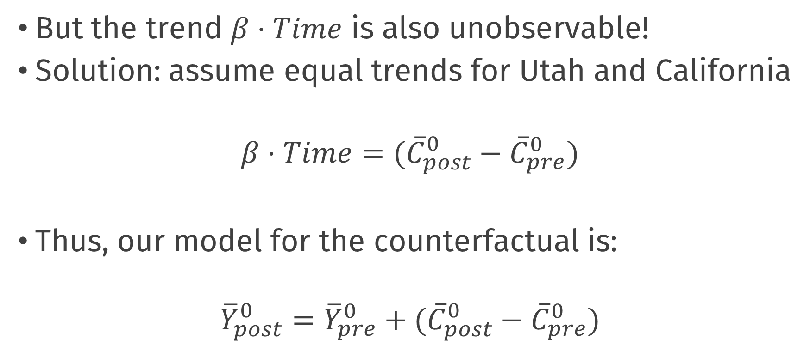
Pre-post estimator
But the trend $β⋅Time$ is also unobservable!
Solution: assume equal trends for Utah and California
$$β⋅Time=({\overline{C}}_{post}^{0}−{\overline{C}}_{pre}^{0})$$
Thus, our model for the counterfactual is:
$${\overline{Y}}_{post}^{0}={\overline{Y}}_{pre}^{0}+({\overline{C}}_{post}^{0}−{\overline{C}}_{pre}^{0})$$

Slide 51
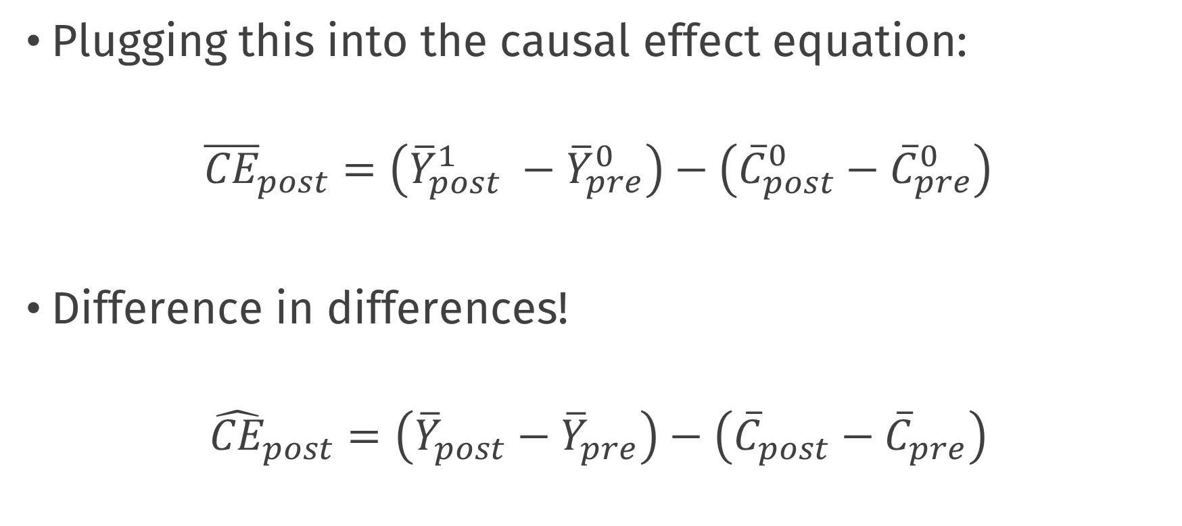
Pre-post estimator
Plugging this into the causal effect equation:
$${\overline{CE}}_{post}=\left({\overline{Y}}_{post}^{1} −{\overline{Y}}_{pre}^{0}\right)−\left({\overline{C}}_{post}^{0}−{\overline{C}}_{pre}^{0}\right)$$
Difference in differences!
$${\hat{CE}}_{post}=\left({\overline{Y}}_{post}−{\overline{Y}}_{pre}\right)−\left({\overline{C}}_{post}−{\overline{C}}_{pre}\right)$$

Slide 52
Difference-in-differences

Slide 53
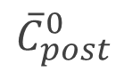
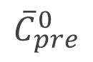
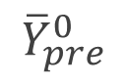
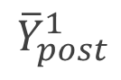
Difference-in-differences
$${\overline{Y}}_{pre}^{0}$$
$${\overline{Y}}_{post}^{1}$$
$${\overline{C}}_{pre}^{0}$$
$${\overline{C}}_{post}^{0}$$

Slide 54
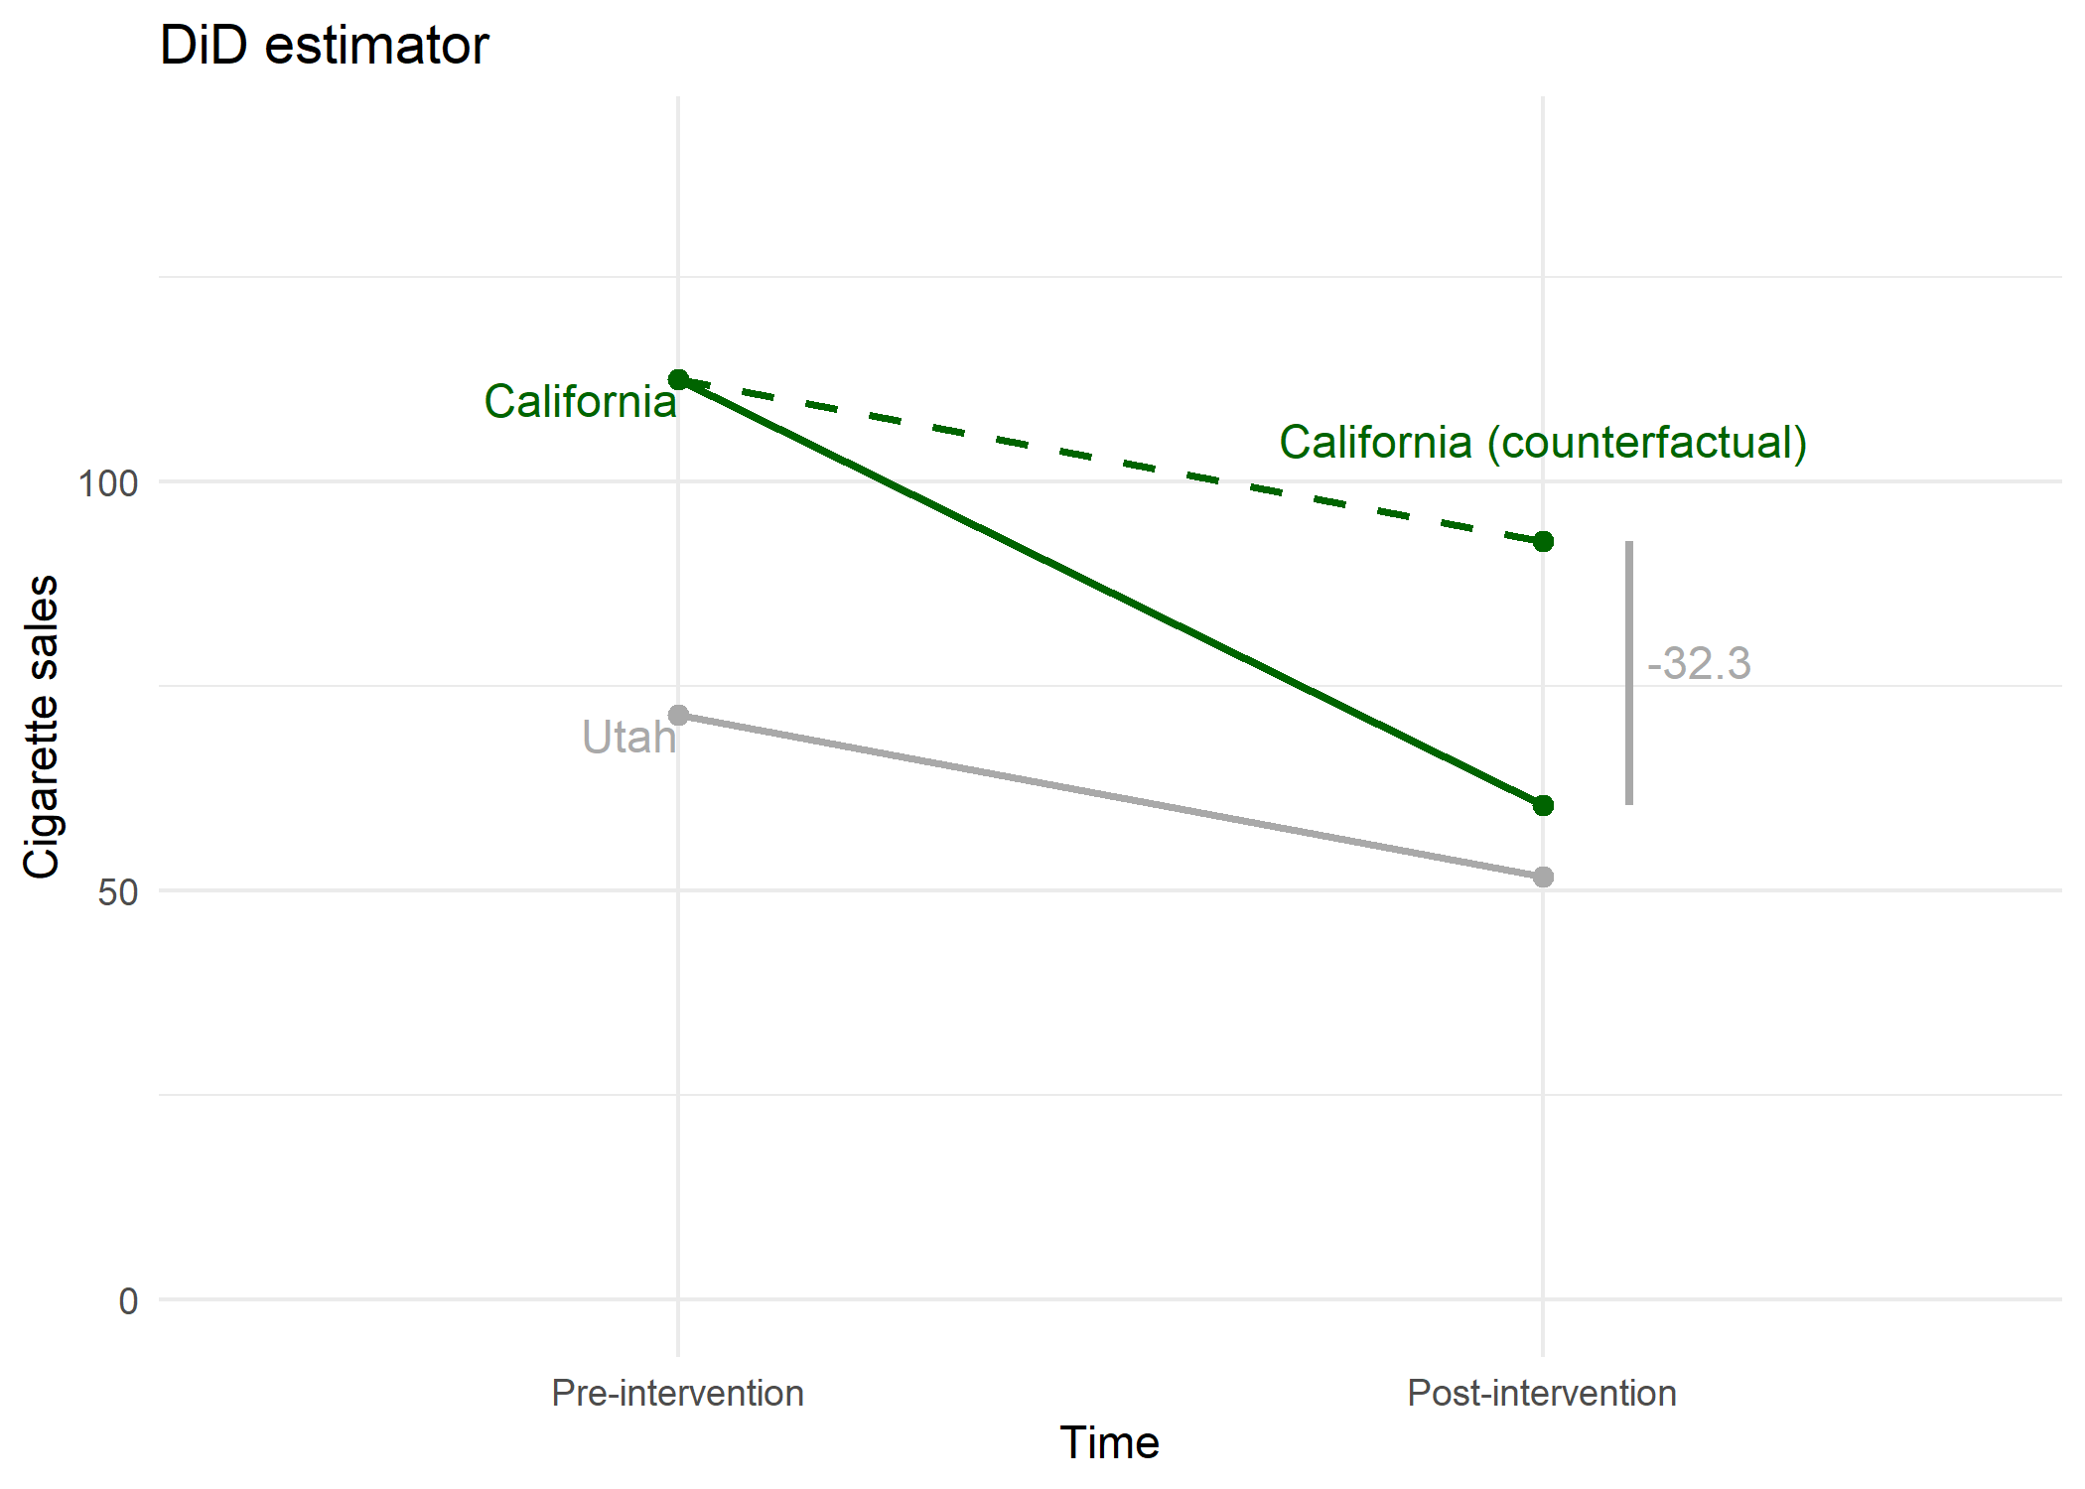
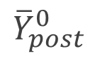
Difference-in-differences
$${\overline{Y}}_{pre}^{0}$$
$${\overline{Y}}_{post}^{0}$$
$${\overline{Y}}_{post}^{1}$$
$${\overline{C}}_{pre}^{0}$$
$${\overline{C}}_{post}^{0}$$

Slide 55
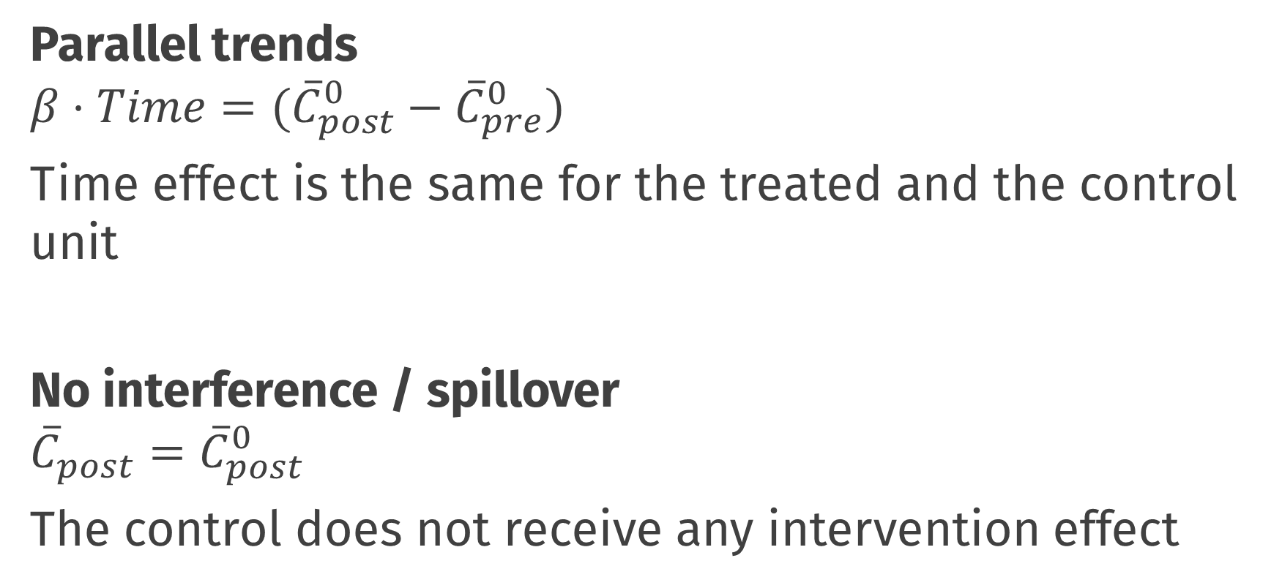
Most important assumptions
Parallel trends
$$β⋅Time=({\overline{C}}_{post}^{0}−{\overline{C}}_{pre}^{0})$$
Time effect is the same for the treated and the control unit
No interference / spillover
$${{\overline{C}}_{post}=\overline{C}}_{post}^{0}$$
The control does not receive any intervention effect
Notes:
No interference; the fact that California has a smoking ban has no effect on cigarette sales in Utah (cig sales in Utah is the same as it would have been if California had no cigarette ban).

Slide 56
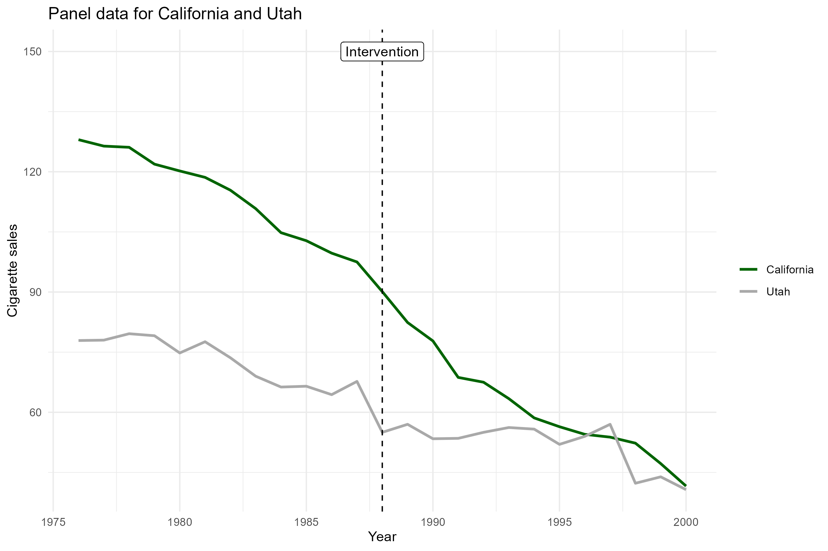
Most important assumptions
Can we assume parallel trends?
At least superficially plausible ☺

Slide 57
Practical
Work in pairs/groups!
https://is.gd/sicsscausal

Slide 58
Break

